Slide 1




GREEN PROJECT
INTEGRANTES: DAVID ECHAVEZ
BRAHAM GARZON
SEBASTIAN ABRIL

Slide 2

Planteamiento del problema
¿cómo monitorear el estado foliar de los cultivos con herramientas autónomas que demuestren datos hiperespectrales del terreno al agricultor?

Slide 3


OBJETIVO GENERAL
Diseñar un dron que permita arrojar lecturas hiperespectrales del estado foliar de los
cultivos al agricultor.
<a href="https://es.lovepik.com/images/png-944936.html">Drone Png vectors by Lovepik.com</a>

Slide 4


Objetivos especificos
4 establecer qué tipo de simulador y programa de diseño que se utilizara para la creación
del proyecto
1 investigar diferentes estudios, análisis y documentos para el proceso de foliar del
cultivo.
3 establecer una herramienta de simulación y diseño que nos permita entregar un
prototipo de nuestro dron
2 clasificar diferentes tipos de drones y sus aportes en la industria agrícola 4.0.

Slide 5

Implementar un dron capaz de monitorear el riego de los cultivos, mediante sensores y rose adores.

Slide 6
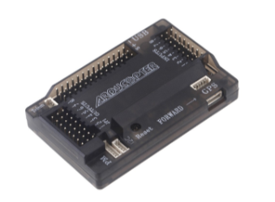
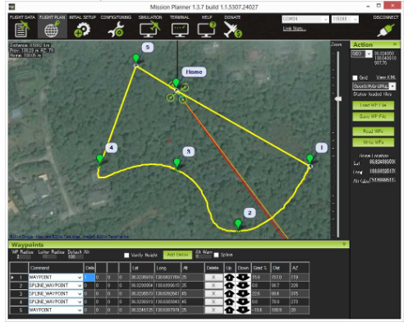
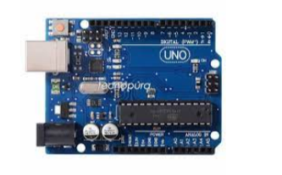
software
Arduino uno.
Controladora APM
software ardupilot.

Slide 7
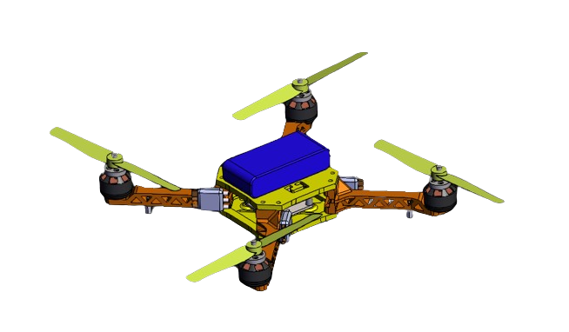
DISEÑO
Se escogió el dron cuadricoptero ya que al tener múltiples rotores nos brinda mayor estabilidad de vuelo y es capaz de soportar cámaras de gran peso sin afectar su estabilidad.
2 soportes 1 inferior y superior el cual se va encargar de darle rigidez a la estructura.
4 brazos los cual brindarán estabilidad y servirán de soporte para cableado y rotores del dron.
4 rotores el cual hará girar las hélices del dron generando potencia y manteniéndolo en el aire se implementaran motores trifásicos los cuales son precisos y potentes consumen menos energía y generan un mayor rango de giro.

Slide 8

Factores de riesgo
Falta de apoyo en el proyecto y deserción de un integrante
El tiempo de ejecución del proyecto se vea corto con presupuesto y alcance para realizarlo
deserción de más integrantes y total abandono del proyecto
Bajo
Medio
Alto

Slide 9
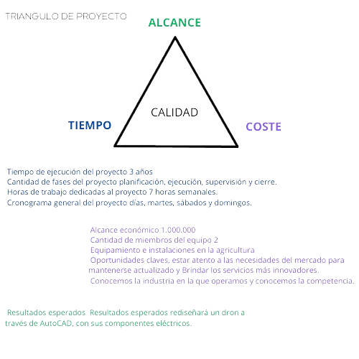

Triángulo del proyecto

Slide 10
02
Click here to enter the title text
Click here to add your title
Add title
Please add specific content here, the text should be as concise as possible, simple description, not too cumbersome, pay attent
Add title
Please add specific content here, the text should be as concise as possible, simple description, not too cumbersome, pay attent
Add title
Please add specific content here, the text should be as concise as possible, simple description, not too cumbersome, pay attent

Slide 11

02
Click here to enter the title text
Click here to add your title
Click here to add title
Please add specific content here, the text should be as concise as possible, simple description, not too cumbersome, pay attent
Click here to add title
Please add specific content here, the text should be as concise as possible, simple description, not too cumbersome, pay attent
Click here to add title
Please add specific content here, the text should be as concise as possible, simple description, not too cumbersome, pay attent

Slide 12

02
Click here to enter the title text
Click here to add your title
Click here to enter a title
Click here to enter a title
A
C
Please add specific content here, the text should be as concise as possible, simple description, not too cumbersome, pay attent
Please add specific content here, the text should be as concise as possible, simple description, not too cumbersome, pay attent
Click here to enter a title
Click here to enter a title
B
D
Please add specific content here, the text should be as concise as possible, simple description, not too cumbersome, pay attent
Please add specific content here, the text should be as concise as possible, simple description, not too cumbersome, pay attent

Slide 13
PART O3
Please add a text title
Please add specific content here, the text should be as concise as possible, simple description, not too cumbersome, pay attent

Slide 14

03
Click here to enter the title text
Click here to add your title
01 Add title
Please add specific content here, the text should be as concise as possible, simple description, not too cumbersome, pay attentPlease add specific content here, the text should be as concise as possible, simple description, not too cumbersome, pay attent
02 Add title
Please add specific content here, the text should be as concise as possible, simple description, not too cumbersome, pay attentPlease add specific content here, the text should be as concise as possible, simple description, not too cumbersome, pay attent

Slide 15

03
Click here to enter the title text
Click here to add your title
01 Add title
Please add specific content here, the text should be as concise as possible, simple description, not too cumbersome, pay attent
03 Add title
Please add specific content here, the text should be as concise as possible, simple description, not too cumbersome, pay attent
02 Add title
Please add specific content here, the text should be as concise as possible, simple description, not too cumbersome, pay attent

Slide 16
03
Click here to enter the title text
Click here to add your title
Add title
Add title
Please add specific content here, the text should be as concise as possible, simple description, not too cumbersome, pay attent
Please add specific content here, the text should be as concise as possible, simple description, not too cumbersome, pay attent
01
06
Add title
Add title
Please add specific content here, the text should be as concise as possible, simple description, not too cumbersome, pay attent
02
05
Please add specific content here, the text should be as concise as possible, simple description, not too cumbersome, pay attent
03
04
Add title
Add title
Please add specific content here, the text should be as concise as possible, simple description, not too cumbersome, pay attent
Please add specific content here, the text should be as concise as possible, simple description, not too cumbersome, pay attent

Slide 17
03
Click here to enter the title text
Click here to add your title
Add title
Please add specific content here, the text should be as concise as possible, simple description, not too cumbersome, pay attent
Add title
Please add specific content here, the text should be as concise as possible, simple description, not too cumbersome, pay attent
Add title
Please add specific content here, the text should be as concise as possible, simple description, not too cumbersome, pay attent
Add title
Please add specific content here, the text should be as concise as possible, simple description, not too cumbersome, pay attent

Slide 18
PART O4
Please add a text title
Please add specific content here, the text should be as concise as possible, simple description, not too cumbersome, pay attent

Slide 19

04
Click here to enter the title text
Click here to add your title
Add title
Please add specific content here, the text should be as concise as possible, simple description, not too cumbersome, pay attent
Add title
Please add specific content here, the text should be as concise as possible, simple description, not too cumbersome, pay attent
Add title
Please add specific content here, the text should be as concise as possible, simple description, not too cumbersome, pay attent

Slide 20
04
Click here to enter the title text
Click here to add your title
01
02
03
Add title
Please add specific content here, the text should be as concise as possible, simple description, not too cumbersome, pay attent
Add title
Please add specific content here, the text should be as concise as possible, simple description, not too cumbersome, pay attent
Add title
Please add specific content here, the text should be as concise as possible, simple description, not too cumbersome, pay attent

Slide 21
04
Click here to enter the title text
Click here to add your title
01 Add title
Please add specific content here, the text should be as concise as possible, simple description, not too cumbersome, pay attent
02 Add title
Please add specific content here, the text should be as concise as possible, simple description, not too cumbersome, pay attent
03 Add title
Please add specific content here, the text should be as concise as possible, simple description, not too cumbersome, pay attent

Slide 22
04
Click here to enter the title text
Click here to add your title
Please add specific content here, the text should be as concise as possible, simple description, not too cumbersome, pay attent
Please add specific content here, the text should be as concise as possible, simple description, not too cumbersome, pay attent
Please add specific content here, the text should be as concise as possible, simple description, not too cumbersome, pay attent
Please add specific content here, the text should be as concise as possible, simple description, not too cumbersome, pay attent

Slide 23
04
Click here to enter the title text
Click here to add your title
Click here to add title
Please add specific content here, the text should be as concise as possible, simple description, not too cumbersome, pay attent
Click here to add title
Please add specific content here, the text should be as concise as possible, simple description, not too cumbersome, pay attent
Click here to add title
Please add specific content here, the text should be as concise as possible, simple description, not too cumbersome, pay attent

Slide 24
2019
THANK YOU FOR YOUR APPRECIATION
THE PROFESSIONAL POWERPOINT TEMPLATES
Reporter: XXX
Reporting time: 2018

